Slide 1


GOAL: Players flips over two cards to find a matching pair. If the pictures on the cards are not the same, the cards are turned back over.

Slide 2

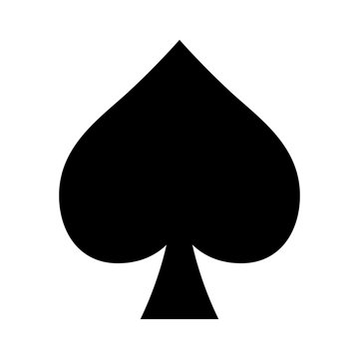

L
E
T
S
T
R
Y
!
1
2
3
4

Slide 3



1
2
3
4
5
6

